Slide 1

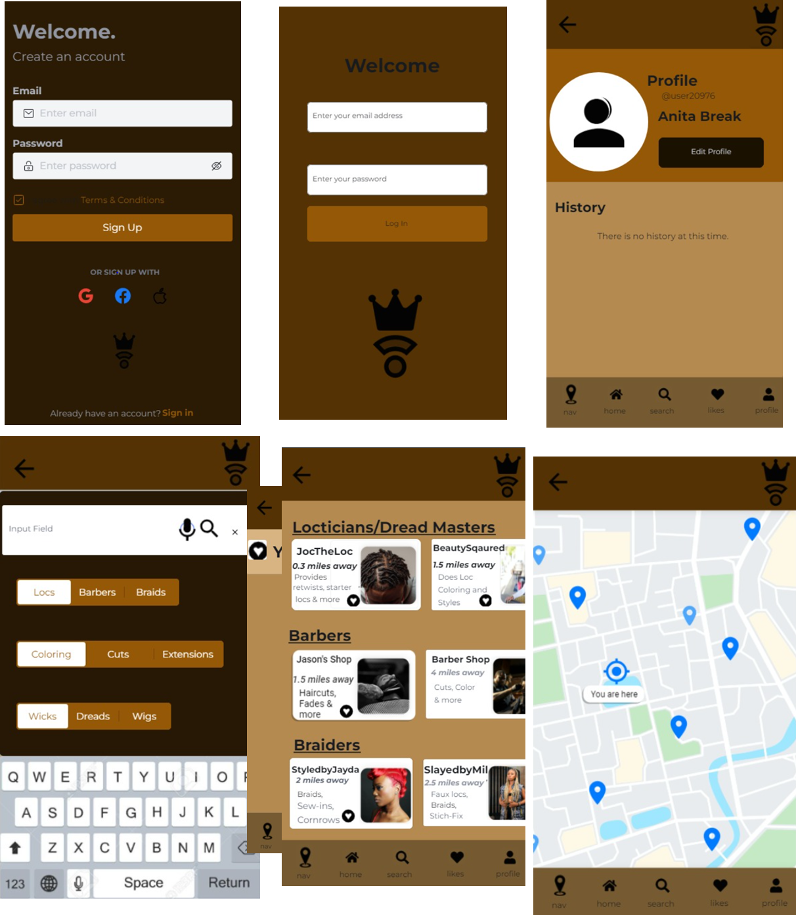
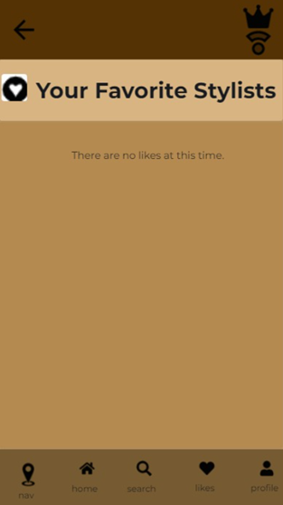
Crown Compass
Oliva Adoghe Michael Mondelice Xavier Thomas Trinay Smith
COP 3060
Introduction
Wireframe
Conclusion
Crown Compass is an application that displays hairstylists, barbers, and locticians in nearby areas. It also displays their business contacts so that the business can then be thoroughly inspected by the user before deciding to visit. The application also shows reviews and ratings left by previous users, payments can be made through the app as well.
SignUp Screen
User can login
Registration Screen User can create a new account
Search User can search for other service o User can follow/unfollow service
Location based follow hair service User can like service content User can follow hair service
Filter Hair service o User can filter hair service based on preference such as style
The overall usage of Crown Compass is to empower individuals with a service that allows them to find local hair care services within their community. This project has taught us the importance of developing an application and provided features that best fits the user's needs. The need for creating a cohesive integration among the app and APIs is essential to the experience.
Future Works
Objectives
Crown Compass will be an all-inclusive platform that supports having a feed to show local hair care services. A user can tap a photo to view a more detailed photo screen with comments to talk about experience and share photos. User can view a feed of photos and reviews of app reviews and rating.
Story: Inputs users’ locations and specific need between hairstylist, barber and loctician. The user then is presented with options for their choice that’s within the vicinity. Then the user can choose an option, set their appointment and pay for it through the app.
Market: Anyone with a head of hair or facial hair can use this app to find their choice of stylist. To make users less anxious and more trusting in their new stylist images of before and after pictures will be available for each stylist as well as ratings and reviews.
Habit: This app can be used as often as someone goes to the barber or gets their hair done, whether it may be weekly, bi-weekly, monthly or less often.
Technologies
Contact
Software: React js, Java and IntelliJ
Hardware: Mobile Devices and Computers
API: Stripe Payment and Google Maps, Location API
Oliva Adoghe
Michael Mondelice
Xavier Thomas
Trinay Smith

